Slide 1


Slide 2

FALL CHARADES

Slide 3
Roasting Marshmallows

Slide 4
Eating a Candy Apple

Slide 5
Raking Leaves

Slide 6
Carving Pumpkins

Slide 7
Picking Apples

Slide 8
Putting on a Jacket

Slide 9
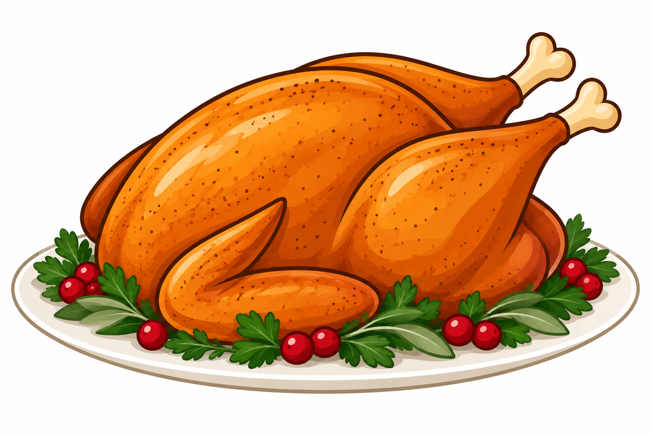
FAMILY
CHARADES

Slide 10
Going to
Grandma’s House

Slide 11
Hugging Relatives

Slide 12
Cooking
Thanksgiving Dinner

Slide 13
Carving the Turkey

Slide 14
Saying the Blessing

Slide 15
Getting too Full at Thanksgiving

Slide 16
FOOTBALL CHARADES

Slide 17
Flipping the Coin for the Coin Toss

Slide 18
Making Referee
Signals

Slide 19
Cheerleading

Slide 20
Doing the Wave

Slide 21
Booing the Refs

Slide 22
Pouring the Drink Cooler on the Coach

